Slide 1
Student Homelessness in New York City Public Schools District 5, SY 2015–16

Slide 2
Student Homelessness in NYC
Nearly 100,000 NYC public school students experienced homelessness during
SY 2015–16.
Unless current trends change,
1 in 7 students will experience homelessness before they finish elementary school.
Source: New York City Department of Education, unpublished data tabulated by the Institute for Children, Poverty, and Homelessness, SY 2015–16.
Notes:
Student Homelessness in NYC

Slide 3
Where Do Homeless Students Sleep?
For every homeless student living in shelter, roughly two more are homeless living in another temporary setting—mostly doubled up.
Source: New York City Department of Education, unpublished data tabulated by the Institute for Children, Poverty, and Homelessness, SY 2015–16.

Slide 4
Most Children Are Homeless for More Than One School Year
Homelessness was not a brief or isolated experience for students citywide.
Two-thirds of homeless students experienced homelessness during more than one school year.
Source: New York City Department of Education, unpublished data tabulated by the Institute for Children, Poverty, and Homelessness, SY 2015–16.

Slide 5
Young Students Are Most at Risk
Students are more likely to experience homelessness when they are young.
During SY 2015–16, 35% of all homeless students were in grades pre-K through 2nd compared to 28% of housed students.
Source: New York City Department of Education, unpublished data tabulated by the Institute for Children, Poverty, and Homelessness, SY 2015–16.

Slide 6
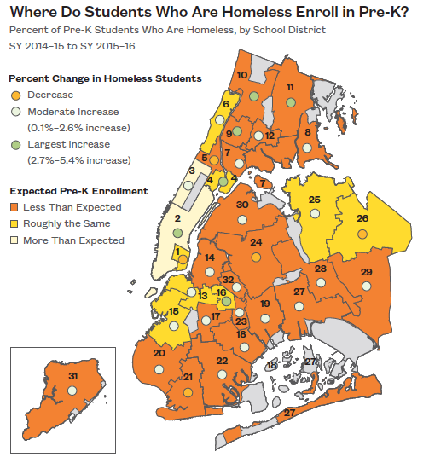
Differences in Pre-K Enrollment
Citywide, pre-K enrollment improved by 17% for children who have been homeless. However, the majority of school districts enrolled fewer homeless pre-K students than would be expected.
Source: New York City Department of Education, unpublished data tabulated by the Institute for Children, Poverty, and Homelessness, SY 2015–16.

Slide 7
Student Homelessness in District 5
Over 2,300 currently homeless students in District 5.
1 in 4 students experienced homelessness in the last six years.
Source: New York City Department of Education, unpublished data tabulated by the Institute for Children, Poverty, and Homelessness, SY 2015–16.
Notes:
School-age children only
Does not include charter schools

Slide 8
Where Do Homeless Students Sleep in District 5?
1,091 students lived in shelters and 1,044 students lived doubled up at some point during SY 2015–16. Another 176 students lived in another temporary setting.
Source: New York City Department of Education, unpublished data tabulated by the Institute for Children, Poverty, and Homelessness, SY 2015–16.

Slide 9
Homelessness and Poverty Among Students in District 5
Among students enrolled, 18% were homeless during SY 2015–16.
Another 6% had been homeless in at least one of the five previous years.
Source: New York City Department of Education, unpublished data tabulated by the Institute for Children, Poverty, and Homelessness, SY 2015–16.

Slide 10
Percent of Homeless Students in Manhattan Districts
Out of six school districts in Manhattan, District 5 had the highest percent of homeless students enrolled at 18%.
Source: New York City Department of Education, unpublished data tabulated by the Institute for Children, Poverty, and Homelessness, SY 2015–16.

Slide 11
Elementary Students Are Most At Risk
Elementary schools had the highest percent of homeless students in District 5.
Source: New York City Department of Education, unpublished data tabulated by the Institute for Children, Poverty, and Homelessness, SY 2015–16.

Slide 12
Student Homelessness by Race and Ethnicity in District 5
Black and Hispanic students were most at risk of experiencing homelessness in District 5.
Source: New York City Department of Education, unpublished data tabulated by the Institute for Children, Poverty, and Homelessness, SY 2015–16.

Slide 13
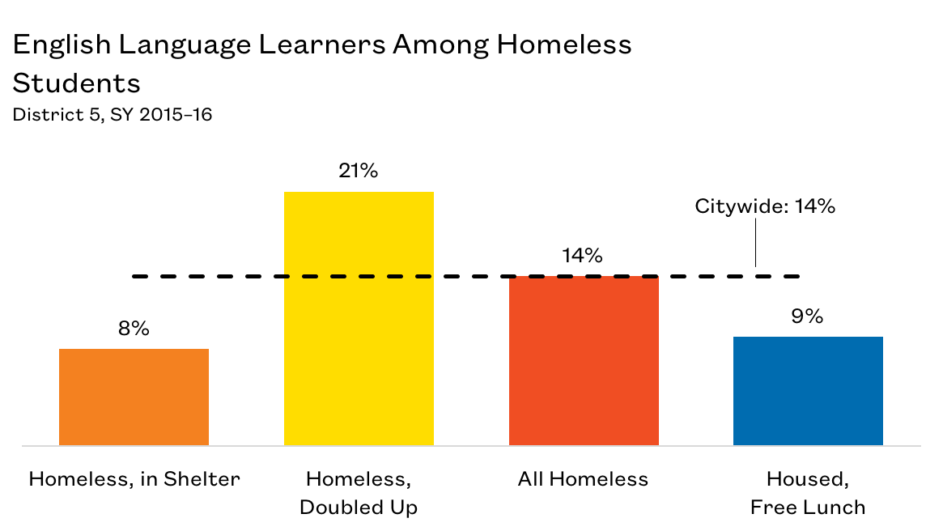
English Language Learners in District 5
1 in 7 homeless students were English Language Learners.
Source: New York City Department of Education, unpublished data tabulated by the Institute for Children, Poverty, and Homelessness, SY 2015–16.

Slide 14
Impacts of Student Homelessness
Transfer schools more often
More likely to be chronically absent
Lower rates of proficiency on state assessments
Higher suspension rates
Lower graduation rates
Higher dropout rates
Require additional ELL supports
Receive late support for special education needs
These impacts last beyond a student’s experience with homelessness

Slide 15
Mid-Year School Transfers in District 5
26% of homeless students transferred schools mid-year.
Students in shelters had the highest mid-year transfer rate at 34%.
Every school transfer is estimated to set a student back academically by up to six months.
Source: New York City Department of Education, unpublished data tabulated by the Institute for Children, Poverty, and Homelessness, SY 2015–16.

Slide 16
Chronic Absenteeism Among Homeless Students in District 5
Students who are chronically absent miss 20 or more days of school in a year.
Nearly half of students living in shelters were chronically absent in District 5.
Source: New York City Department of Education, unpublished data tabulated by the Institute for Children, Poverty, and Homelessness, SY 2015–16.

Slide 17
Chronic Absenteeism Among Homeless Students in District 5
District 5 ranks high compared to other districts in chronic absenteeism among homeless students citywide.
Source: New York City Department of Education, unpublished data tabulated by the Institute for Children, Poverty, and Homelessness, SY 2015–16.

Slide 18
Suspensions of Homeless Students in District 5
Suspension rates among homeless students have declined in the past six years.
In District 5, the suspension rate for homeless students was 2.9%
Source: New York City Department of Education, unpublished data tabulated by the Institute for Children, Poverty, and Homelessness, SY 2015–16.

Slide 19
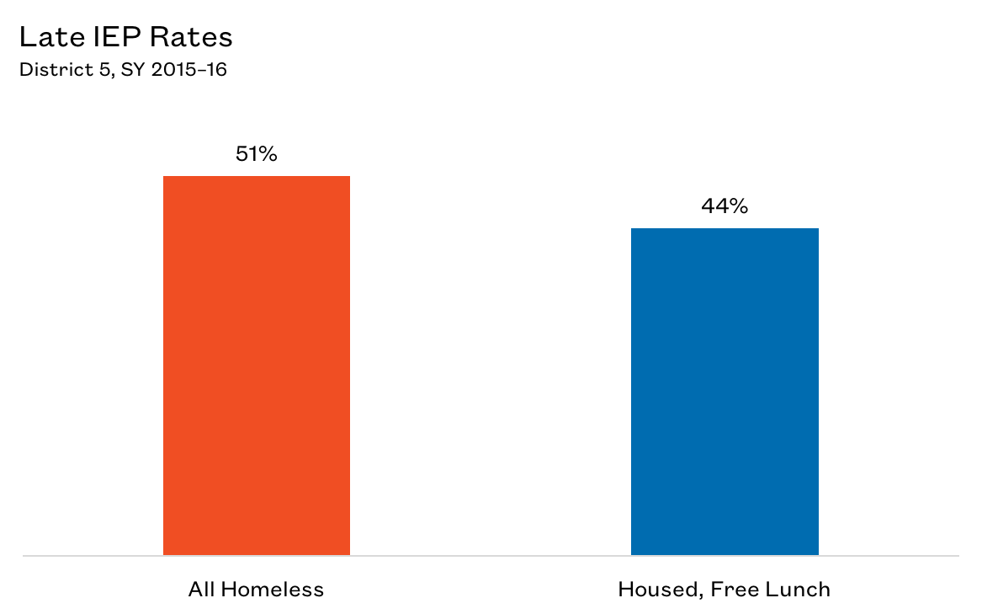
Additional Needs of Homeless Students in District 5
Compared to low-income housed students, homeless students were referred late for special education services at higher rates.
Source: New York City Department of Education, unpublished data tabulated by the Institute for Children, Poverty, and Homelessness, SY 2015–16.

Slide 20
Additional Needs of Students Experiencing Homelessness
Early identification helps students maintain grade level proficiency and ultimately have a better chance of graduating.
Source: New York City Department of Education, unpublished data tabulated by the Institute for Children, Poverty, and Homelessness, SY 2015–16.

Slide 21
3rd–8th Grade State Math Test Proficiency Rates in District 5
In District 5, less than 15% of homeless and formerly homeless students performed at or above grade level on the state math assessment.
Source: New York City Department of Education, unpublished data tabulated by the Institute for Children, Poverty, and Homelessness, SY 2015–16.

Slide 22
3rd–8th Grade State English Language Arts Test Proficiency Rates in District 5
Less than a quarter of homeless and formerly homeless students met the ELA proficiency benchmark.
Recognizing homeless and formerly homeless students as a unique cohort may be the first step in designing solutions that meet their needs and help them overcome educational deficits.
Source: New York City Department of Education, unpublished data tabulated by the Institute for Children, Poverty, and Homelessness, SY 2015–16.

Slide 23
Providing Support and Identifying Opportunities
Citywide, graduation rates for homeless students living in shelter during all of high school were similar to those of low-income housed students.
How can supports be extended to students who are homeless and living outside of shelters?
Source: New York City Department of Education, unpublished data tabulated by the Institute for Children, Poverty, and Homelessness, SY 2015–16.

Slide 24
Dropout Rates for Homeless Students in District 5
The four-year dropout rate for New York City improved slightly from 9.0% for the class of 2015 to 8.5% for the class of 2016, but the achievement gap persisted.
In District 5, homeless students not living in shelters were most at risk of dropping out.
Source: New York City Department of Education, unpublished data tabulated by the Institute for Children, Poverty, and Homelessness, SY 2015–16.

Slide 25
Graduation Rates for Homeless Students in District 5
On average, 73% of New York City high school students graduate within four years.
The graduation rate for homeless students in District 5 was 54%.
Source: New York City Department of Education, unpublished data tabulated by the Institute for Children, Poverty, and Homelessness, SY 2015–16.

Slide 26
Policy Considerations
Identifying students who are homeless is the first step to ensuring these students receive adequate supports.
School staff should continue to proactively connect and collaborate with parents as well as shelter staff to address the issues of chronic absenteeism and high school dropouts among homeless students.
Ensure school staff are knowledgeable about the various community resources and can effectively direct families to appropriate services (i.e., community health centers, housing assistance, after-school enrichment programs, etc.).

Slide 29
Thank You!
media@ICPHusa.org 212.358.8086 To download copies of our publications: http://www.ICPHusa.org/publications/reports/

