Slide 1

Student Homelessness in
New York City Public Schools
District 24, SY 2015–16

Slide 2
Student Homelessness in NYC
Nearly 100,000 NYC public school students experienced homelessness during SY 2015-16.
Unless current trends change,
1 in 7 students will experience homelessness before they finish elementary school.
Source: New York City Department of Education, unpublished data tabulated by the Institute for Children, Poverty, and Homelessness, SY 2015–16.
Notes:
Student Homelessness in NYC

Slide 3
Where Do Homeless Students Sleep?
For every homeless student
living in shelter, roughly two more are homeless living in another temporary
setting—mostly doubled up.
Source: New York City Department of Education, unpublished data tabulated by the Institute for Children, Poverty, and Homelessness, SY 2015–16.

Slide 4
Most Children Are Homeless for More Than One School Year
Homelessness was not a
brief or isolated experience
for students citywide.
Two-thirds of homeless students experienced homelessness during more than one school year.
Source: New York City Department of Education, unpublished data tabulated by the Institute for Children, Poverty, and Homelessness, SY 2015–16.

Slide 5
Young Students Are Most at Risk
Students are more likely to experience homelessness when they are young.
During SY 2015–16, 35% of all homeless students were in grades pre-K through 2nd compared to 28% of housed students.
Source: New York City Department of Education, unpublished data tabulated by the Institute for Children, Poverty, and Homelessness, SY 2015–16.

Slide 6
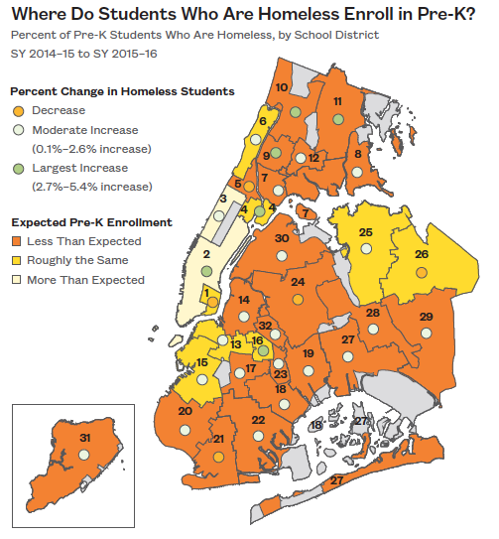
Differences in Pre-K Enrollment
Citywide, pre-K enrollment improved by 17%. However, the majority of school districts enrolled fewer homeless pre-K students than would be expected.
Source: New York City Department of Education, unpublished data tabulated by the Institute for Children, Poverty, and Homelessness, SY 2015–16.

Slide 7
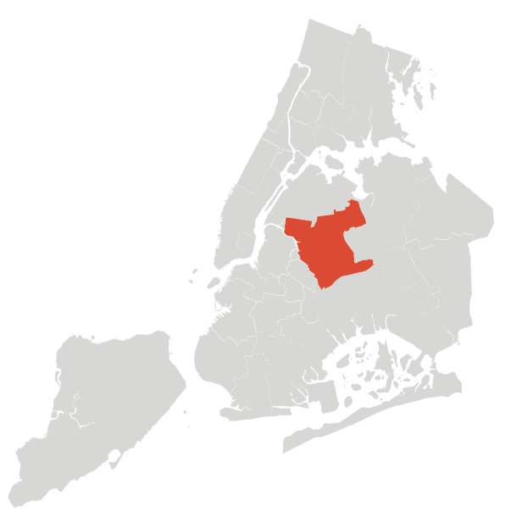
Student Homelessness in District 24
Over 3,500 currently homeless students in District 24.
1 in 12 students experienced homelessness in the last six years.
Source: New York City Department of Education, unpublished data tabulated by the Institute for Children, Poverty, and Homelessness, SY 2015–16.
Notes:
School-age children only
Does not include charter schools

Slide 8
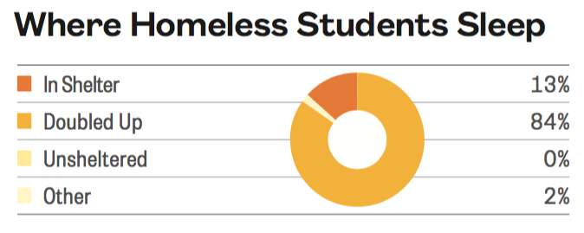
Where Do Homeless Students Sleep in District 24?
475 students lived in shelters and 2,957 students lived doubled up at some point during SY 2015–16. Another 88 students lived in another temporary setting.
Source: New York City Department of Education, unpublished data tabulated by the Institute for Children, Poverty, and Homelessness, SY 2015–16.

Slide 9
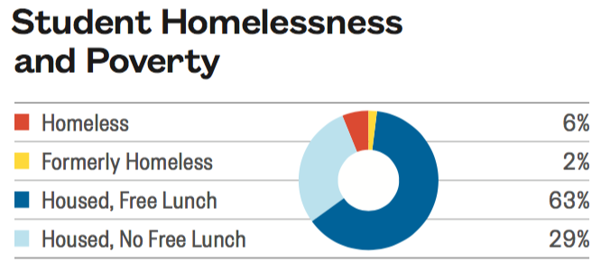
Homelessness and Poverty Among Students in District 24
Among students enrolled, 6% were homeless during SY 2015–16.
Another 2% had been homeless in at least one of the five previous years.
Source: New York City Department of Education, unpublished data tabulated by the Institute for Children, Poverty, and Homelessness, SY 2015–16.

Slide 10
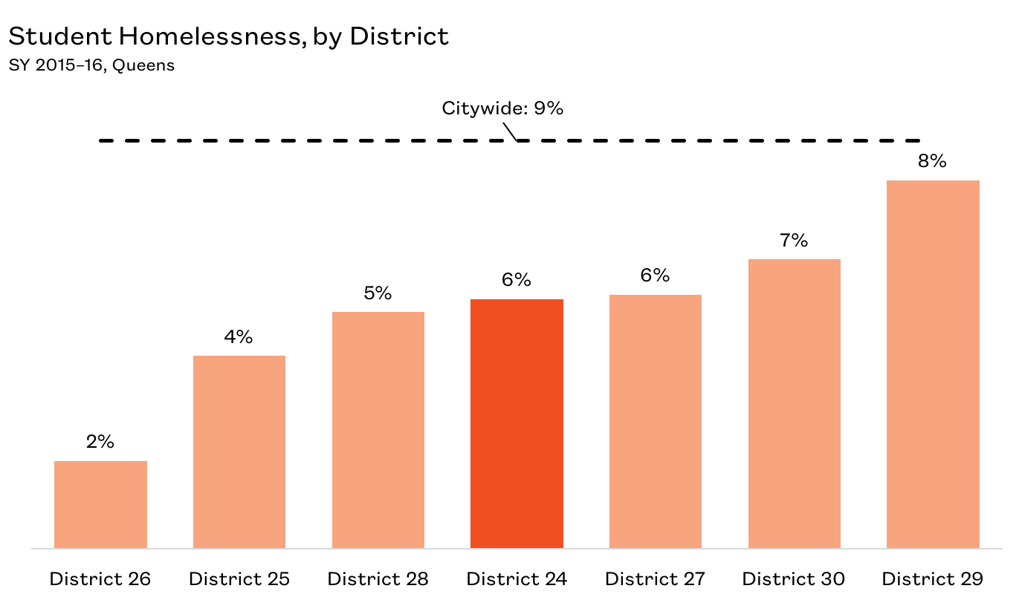
Percentage of Homeless Students in Districts in Queens
Out of seven school districts in Queens, District 24 falls in the middle in terms of homeless students enrolled.
Source: New York City Department of Education, unpublished data tabulated by the Institute for Children, Poverty, and Homelessness, SY 2015–16.

Slide 11
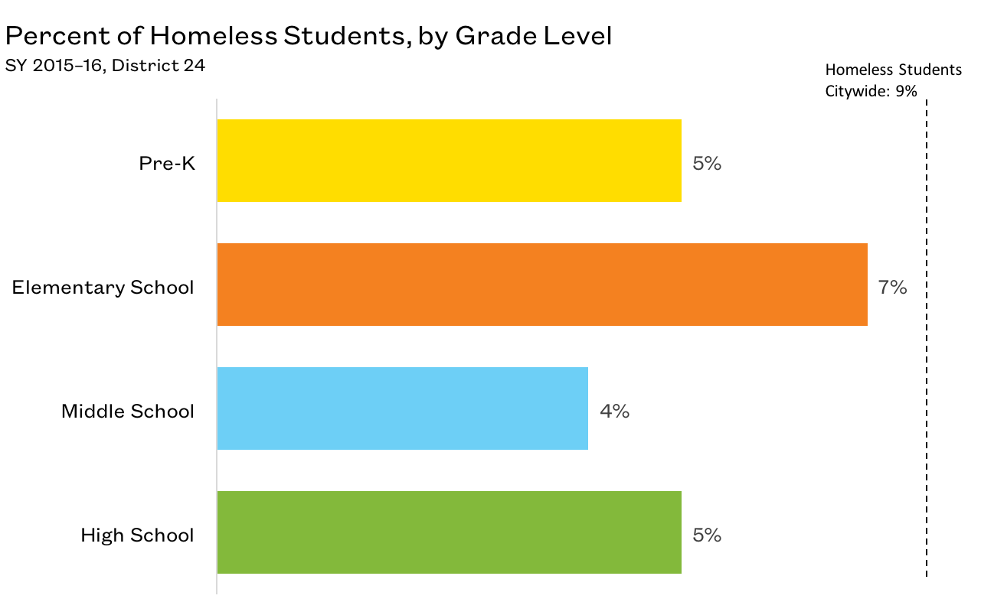
Young Students Are Most At Risk
Elementary schools had the highest percentage of homeless students in District 24.
Source: New York City Department of Education, unpublished data tabulated by the Institute for Children, Poverty, and Homelessness, SY 2015–16.

Slide 12
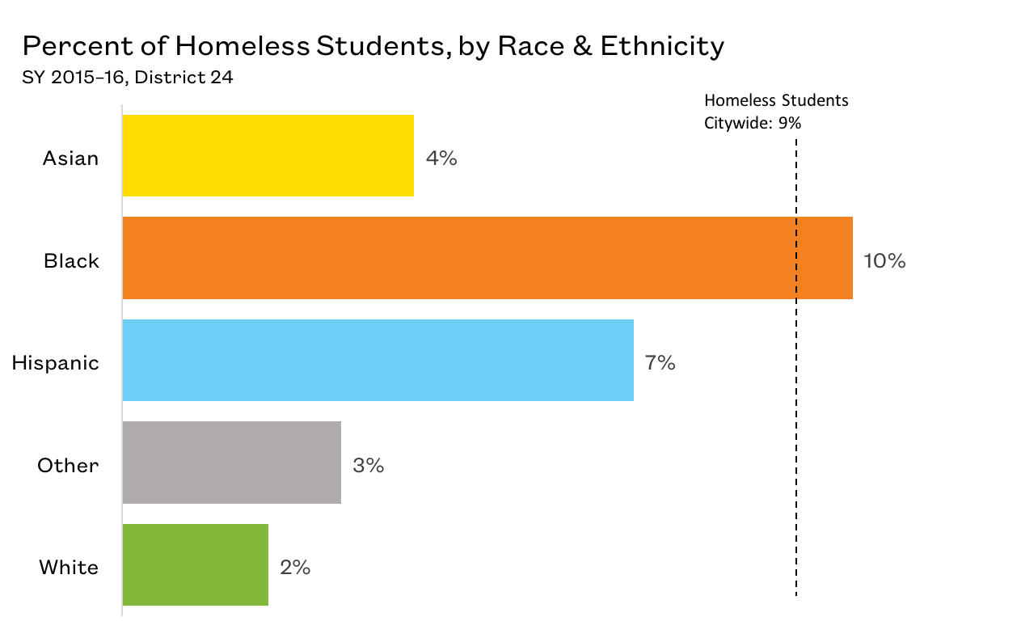
Student Homelessness by Race and Ethnicity in District 24
Black students were most at risk of experiencing homelessness in District 24.
Source: New York City Department of Education, unpublished data tabulated by the Institute for Children, Poverty, and Homelessness, SY 2015–16.

Slide 13
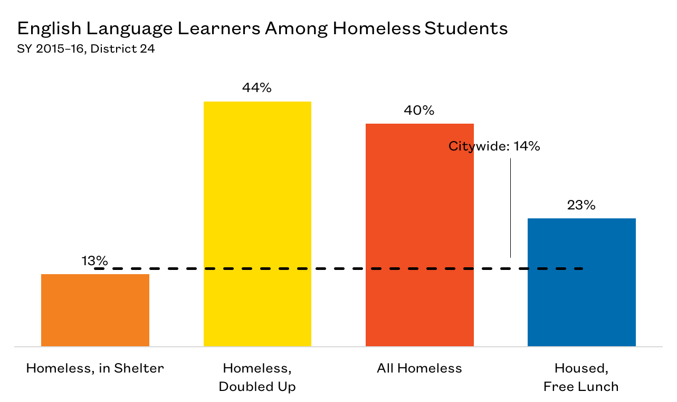
English Language Learners in District 24
40% of homeless
students were English Language Learners.
Source: New York City Department of Education, unpublished data tabulated by the Institute for Children, Poverty, and Homelessness, SY 2015–16.

Slide 14
Impacts of Student Homelessness
  Transfer schools more often
  More likely to be chronically absent
  Lower rates of proficiency on state assessments
  Higher suspension rates
  Lower graduation rates
  Higher dropout rates
  Require additional ELL supports
  Receive late support for special education needs
These impacts last beyond a student’s experience with homelessness

Slide 15
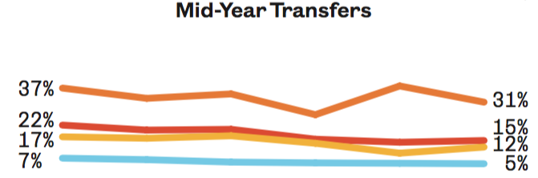

Mid-Year School Transfers in District 24
15% of homeless students transferred schools mid-year.
Students in shelters had the highest mid-year transfer rate at 31%.
Every school transfer is
estimated to set a student
back academically by
up to six months.
SY 2010–11
SY 2015–16
Source: New York City Department of Education, unpublished data tabulated by the Institute for Children, Poverty, and Homelessness, SY 2015–16.

Slide 16
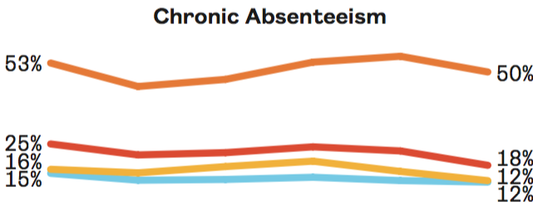
Chronic Absenteeism Among Homeless Students in District 24
Students who are chronically absent miss 20 or more
days of school in a year.
Half of students living in shelters were chronically absent in District 24.
SY 2010–11
SY 2015–16
Source: New York City Department of Education, unpublished data tabulated by the Institute for Children, Poverty, and Homelessness, SY 2015–16.

Slide 17
Chronic Absenteeism Among Homeless Students in District 24
District 24 ranks low for chronic absenteeism among homeless students compared to other districts.
Source: New York City Department of Education, unpublished data tabulated by the Institute for Children, Poverty, and Homelessness, SY 2015–16.

Slide 18
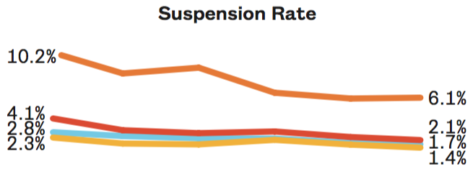

Suspensions of Homeless Students in District 24
Suspension rates among homeless students have declined in the past six years.
In District 24, students living in shelters had the highest suspension rate at 6.1%.
Source: New York City Department of Education, unpublished data tabulated by the Institute for Children, Poverty, and Homelessness, SY 2015–16.

Slide 19
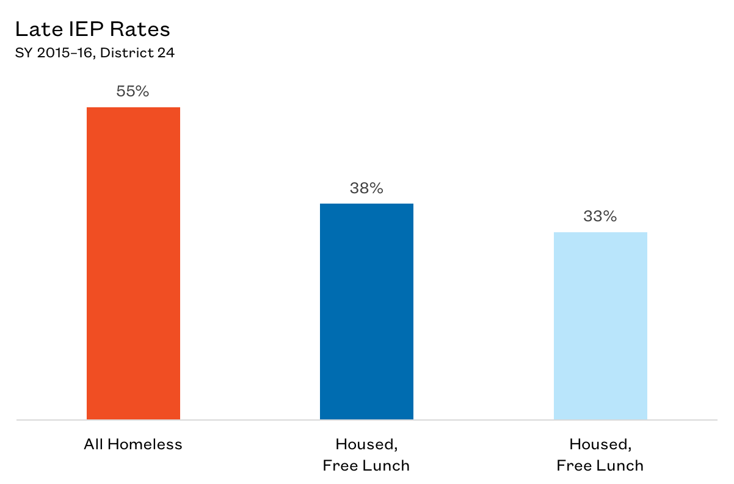
Additional Needs of Homeless Students in District 24
Compared to low-income housed students, homeless students were referred late for special education services at higher rates.
Source: New York City Department of Education, unpublished data tabulated by the Institute for Children, Poverty, and Homelessness, SY 2015–16.

Slide 20
Additional Needs of Students Experiencing Homelessness
Early identification helps students maintain grade level proficiency and ultimately have a better chance of graduating.
Source: New York City Department of Education, unpublished data tabulated by the Institute for Children, Poverty, and Homelessness, SY 2015–16.

Slide 21
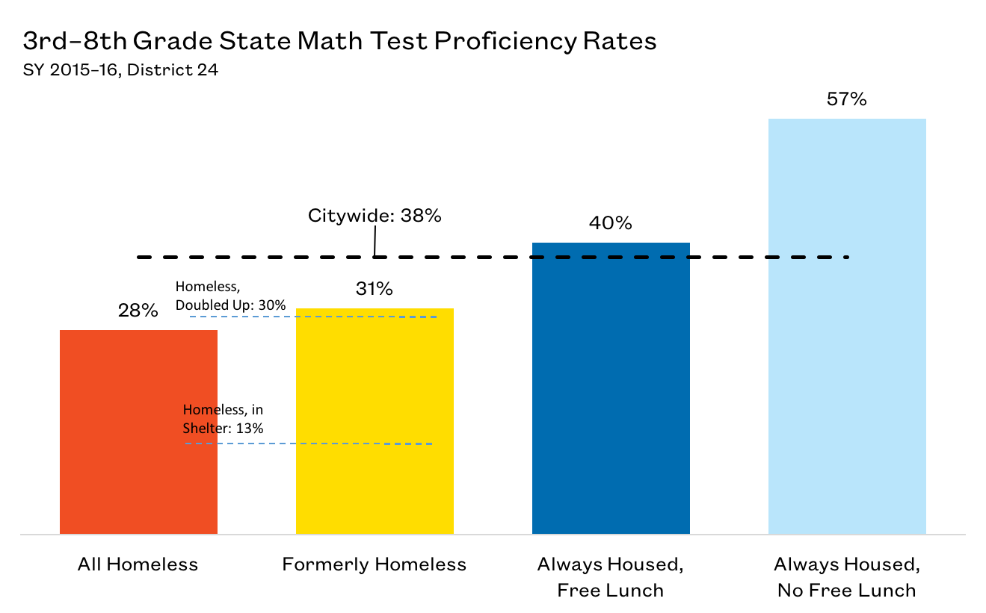
3rd–8th Grade State Math Test Proficiency Rates in District 24
In District 24, only around a quarter of homeless students met the proficiency benchmark in math.
Source: New York City Department of Education, unpublished data tabulated by the Institute for Children, Poverty, and Homelessness, SY 2015–16.

Slide 22
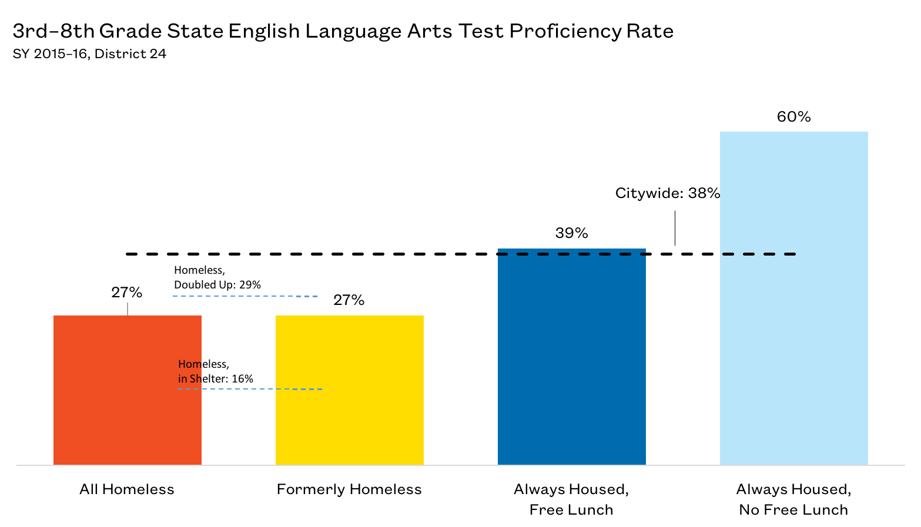
3rd–8th Grade State English Language Arts Test Proficiency Rates in District 24
Less than 30% of all homeless and formerly homeless students met the proficiency benchmark in ELA.
Recognizing homeless and formerly homeless students
as a unique cohort may be the
first step in designing solutions
that meet their needs
and help them overcome educational deficits.
Source: New York City Department of Education, unpublished data tabulated by the Institute for Children, Poverty, and Homelessness, SY 2015–16.

Slide 23
Providing Support and Identifying Opportunities
Citywide, the graduation rate for homeless students living in shelter during all of high school were similar to that of low-income housed students.
How can supports be extended to students who are homeless and living outside of shelters?
Source: New York City Department of Education, unpublished data tabulated by the Institute for Children, Poverty, and Homelessness, SY 2015–16.

Slide 24
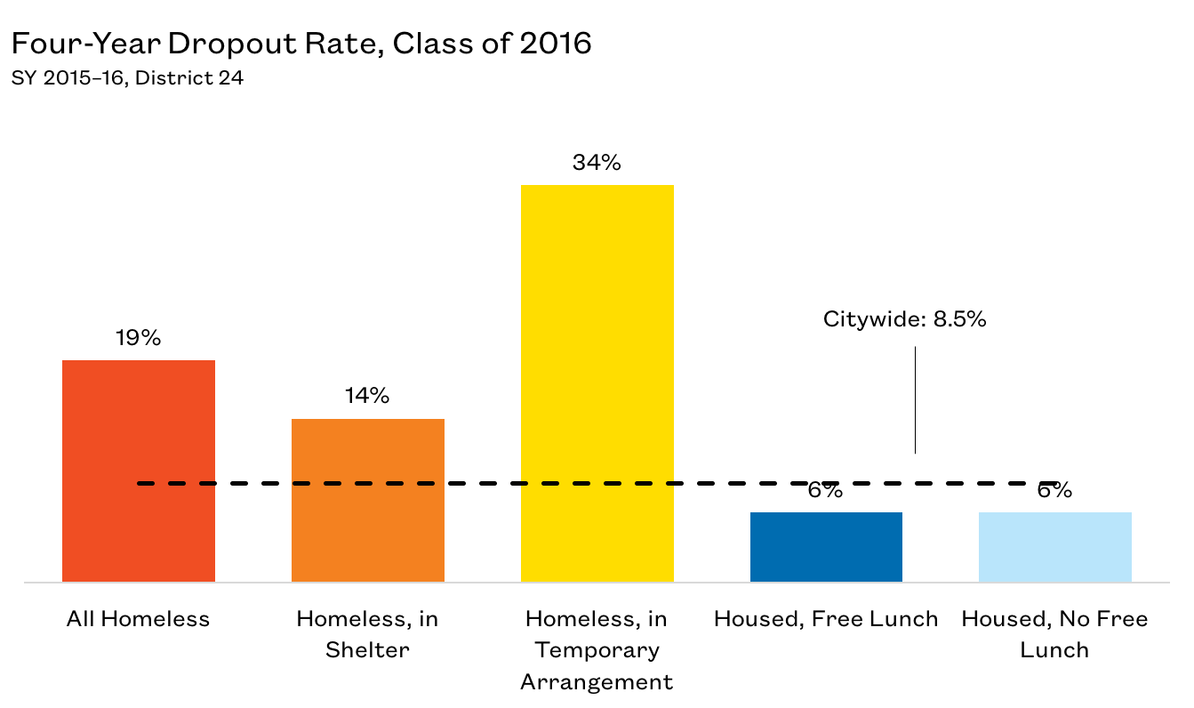
Dropout Rates for Homeless Students in District 24
The four-year dropout rate for New York City improved slightly from 9.0% for the class of 2015 to 8.5% for the class of 2016, but the achievement gap persisted.
The dropout rate in District 24 among homeless students was over two times the citywide rate.
Source: New York City Department of Education, unpublished data tabulated by the Institute for Children, Poverty, and Homelessness, SY 2015–16.

Slide 25
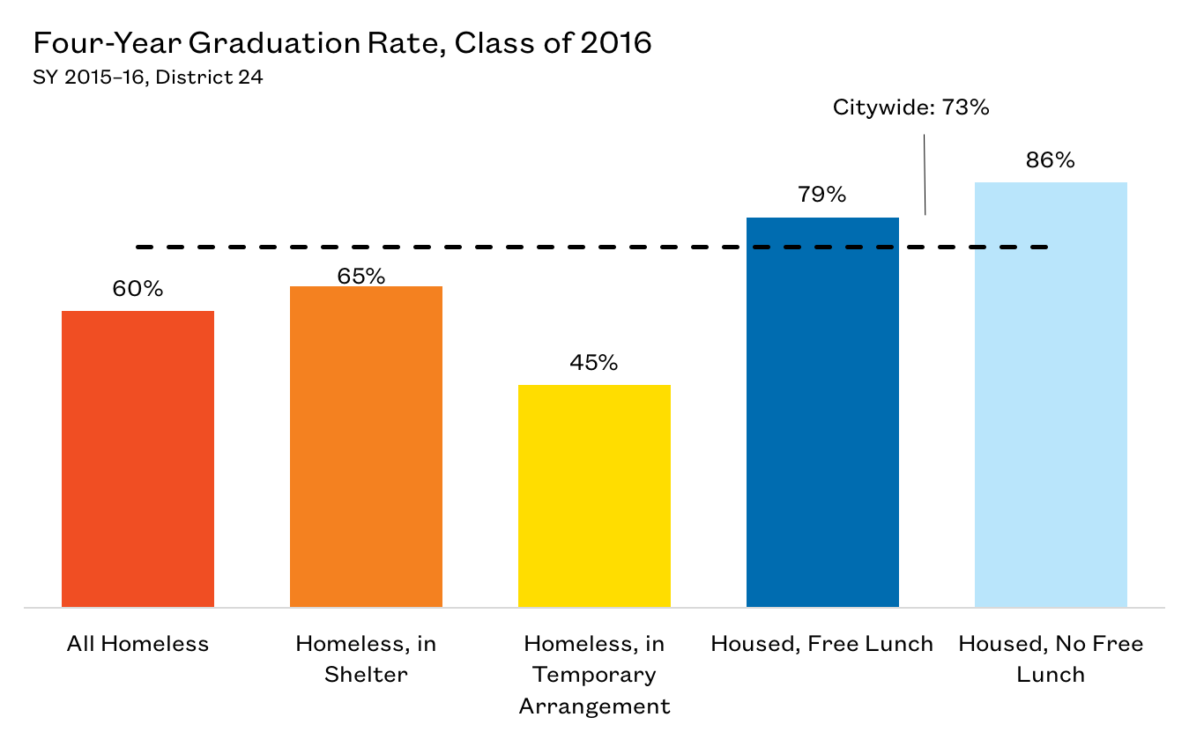
Graduation Rates for Homeless Students in District 24
On average, 73% of New York City high school students graduate within four years.
The graduation rate for homeless students in District 24 was 60%.
Source: New York City Department of Education, unpublished data tabulated by the Institute for Children, Poverty, and Homelessness, SY 2015–16.

Slide 26
Policy Considerations
Identifying students who are homeless is the first step to ensuring these students receive adequate supports.
School staff should continue to proactively connect and collaborate with parents as well as shelter staff to address the issues of chronic absenteeism and high school dropouts among homeless students.
Ensure school staff are knowledgeable about the various community resources and can effectively direct families to appropriate services (i.e., community health centers, housing assistance, after-school enrichment programs, etc.).

Slide 27
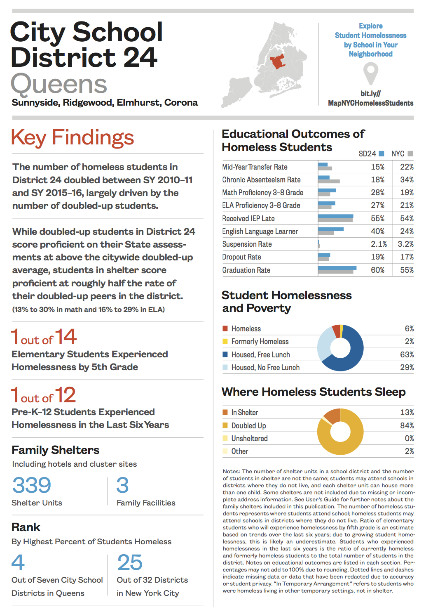
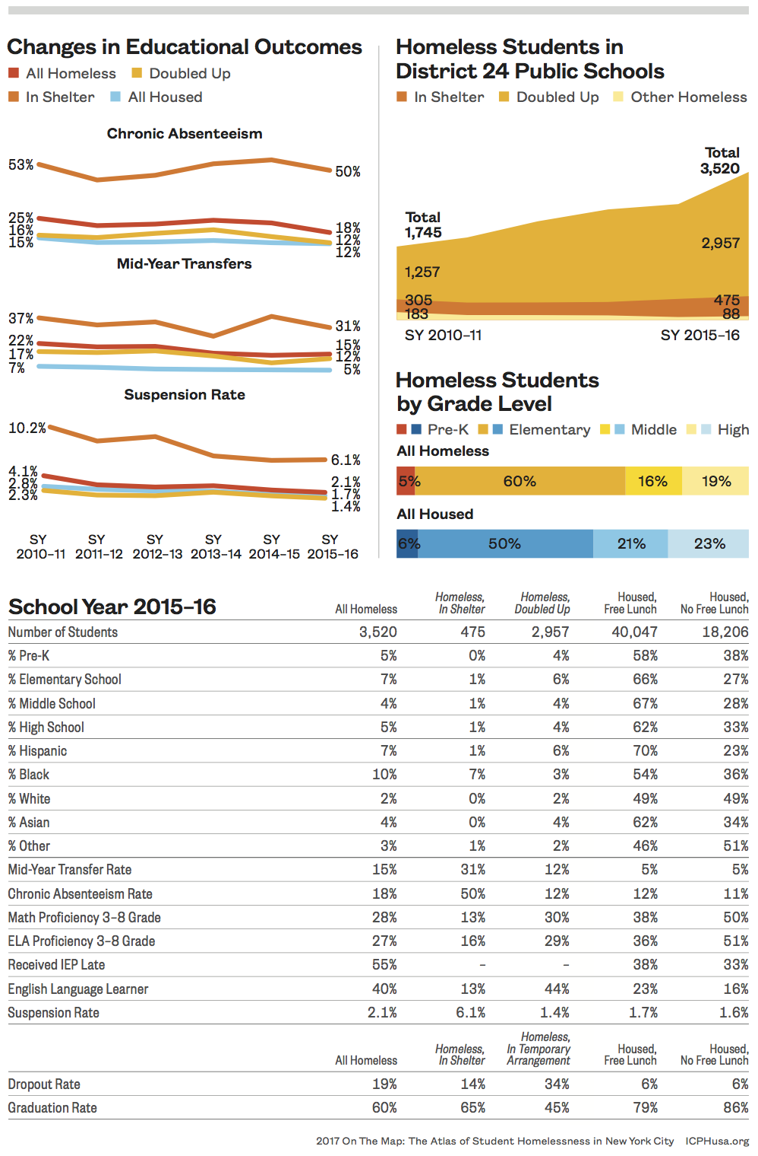

Slide 28
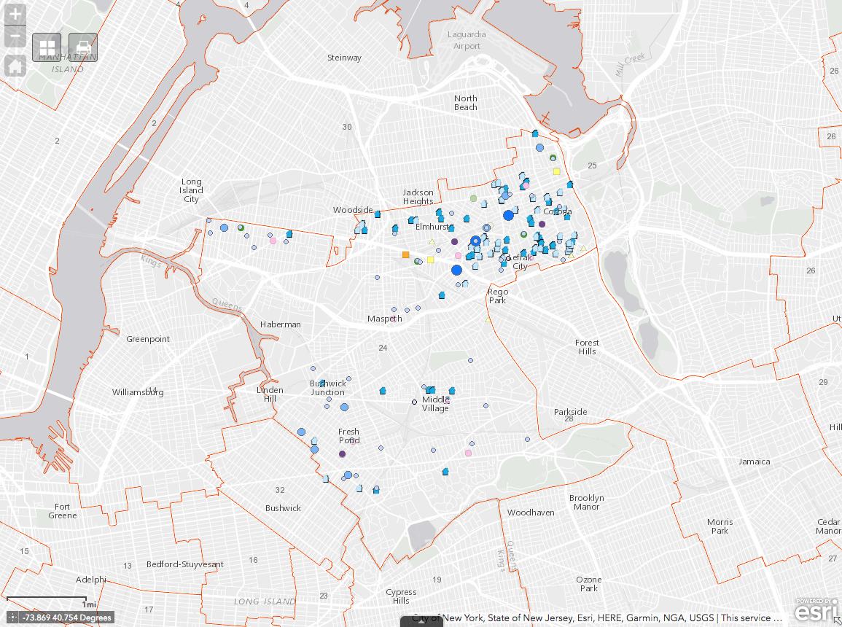
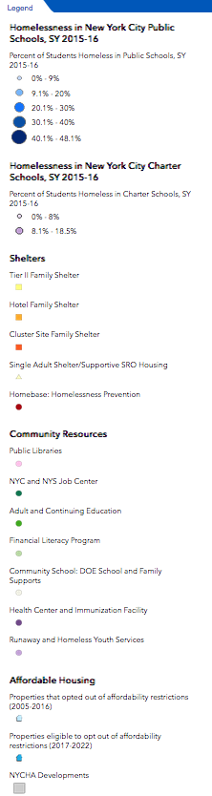
School District 24

Slide 29
Thank You!
media@ICPHusa.org
212.358.8086
To download copies of our publications:
http://www.ICPHusa.org/publications/reports/

